Slide 1

Introduction to Organizational Leadership
Ms. Sandali Ehalapitiya | Assistant Lecturer | SLIIT Business School

Slide 2

Learning Outcomes
At the end of this lesson students should be able to;
Understand the concepts of leadership and management.
Distinguish between leaders and managers.

Slide 3

Contents
Leadership
Levels of leadership
Organizational leadership
Leadership qualities & skills
Management
Management process
Managerial levels
Managerial skills
Leader Vs Managers

Slide 4

What is Leadership?
Leadership is the process of influencing and guiding others to achieve intended goals.
It involves inspiring and motivating people to contribute towards the success or successful attainment of the intended goals.
Leadership exists at different levels.
Team Leadership
Organizational Leadership
Community Leadership
National Leadership
Global Leadership

Slide 5

What is Organizational Leadership?
Organizational leadership is the process of influencing and guiding organizational members to achieve broader organizational goals.
It involves inspiring and motivating organizational employees to contribute towards the success of the organization.

Slide 6

Leadership Qualities
Leadership qualities are the inherent characteristics or attributes that effective leaders possess.
Vision
Integrity
Confidence
Responsibility
Empathy
Adaptability

Slide 7

Leadership Skills
Leadership skills are the specific abilities or competencies that leaders develop and utilize to effectively lead others and achieve organizational goals.
Communication Skills
Decision-Making Skills
Adaptability Skills
Problem-Solving Skills
Team Building Skills
Emotional Intelligence

Slide 8

Management

Slide 9
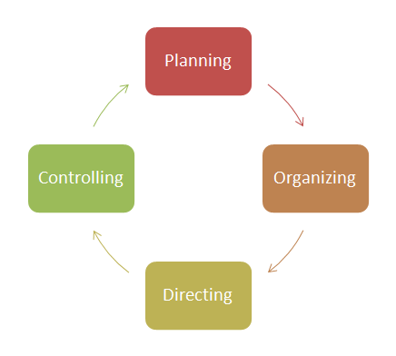
What is Management?
Management is the process of planning, organizing, directing, and controlling resources to achieve specific goals.
It involves coordinating activities and resources to ensure the effective and efficient operation of an organization.

Slide 10
Vision:
To be the most innovative biscuit manufacturer leading the biscuit market in South Asia
For that, as a company, you will have to innovate new biscuit varieties continuously.
Planning:
Set goals & determining action plans
Set a goal to introduce 6 new biscuit varieties annually.
Every 2 months a new biscuit has to be released from the company.

Slide 11
Vision:
To be the most innovative biscuit manufacturer leading the biscuit market in South Asia
For that, as a company, you will have to innovate new biscuit varieties continuously.
Organizing:
Allocating tasks and resources
Allocate experts and form a new product development team.
Allocate funds & facilities for research & development.
Assign responsibility for the team to produce one new biscuit variety, every 2 months.

Slide 12
Vision:
To be the most innovative biscuit manufacturer leading the biscuit market in South Asia
For that, as a company, you will have to innovate new biscuit varieties continuously.
Directing:
Driving & pushing people towards goal attainment
Give the needful drive and guidance to the team periodically.
Accolade them for achieving targets, by appropriate methods of appreciation.

Slide 13
Vision:
To be the most innovative biscuit manufacturer leading the biscuit market in South Asia
For that, as a company, you will have to innovate new biscuit varieties continuously.
Controlling:
Checking if everything is going as planned
Review if the team is producing new biscuit varieties as planned.
i.e., Has the team produced one new biscuit variety by the months of (1)February, (2)April, (3)June, (4)August, (5)October and (6)December.

Slide 14
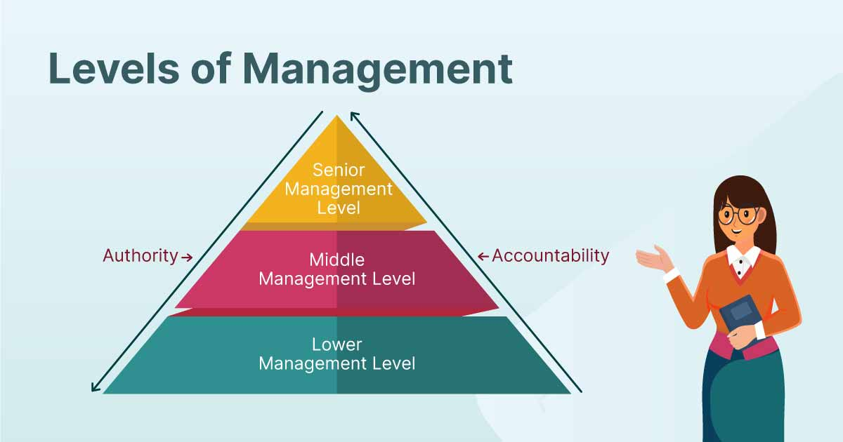
Managerial Levels
Top Level
Chief Executive Officer (CEO)
Managing Director
Chief Operating Officer (COO)
Middle Level
Production Manager
Department Manager
Branch Manager
Lower Level
Sales Supervisor
Team Supervisor
Line Supervisor

Slide 15
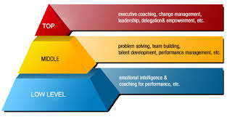
Managerial Levels
Top Level Managers
Strategic decision making
Setting organizational vision and goals
Middle Level Managers
Implementing strategies
Coordinating departments and teams
Lower-Level Managers
Supervising daily operations
Managing frontline employees

Slide 16



Managerial Skills
Conceptual Skills
Ability to see the big picture, think strategically, and solve complex problems.
Example: A CEO developing a new business strategy for international expansion.
Technical Skills
Specific knowledge and abilities related to specialized tasks and processes.
Example: A Production Manager knowing how to operate and troubleshoot sewing machines.
Human Skills
Ability to work well with others, communicate effectively, and manage relationships.
Example: A Manager resolving conflicts and motivating staff.

Slide 17
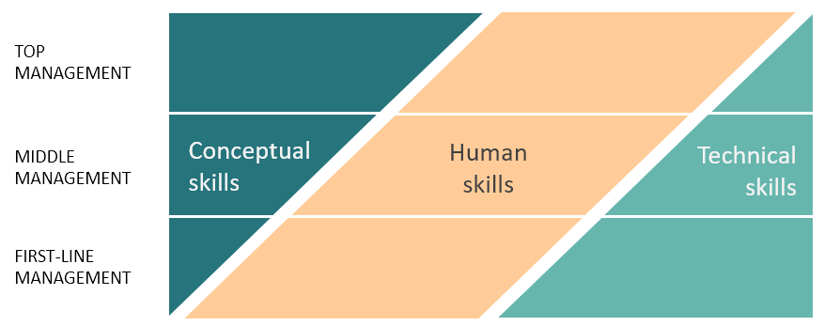
Managerial Levels Vs. Managerial Skills

Slide 18
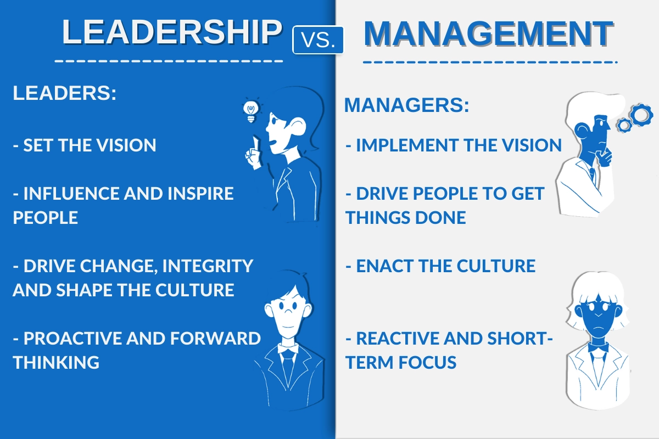

Slide 19
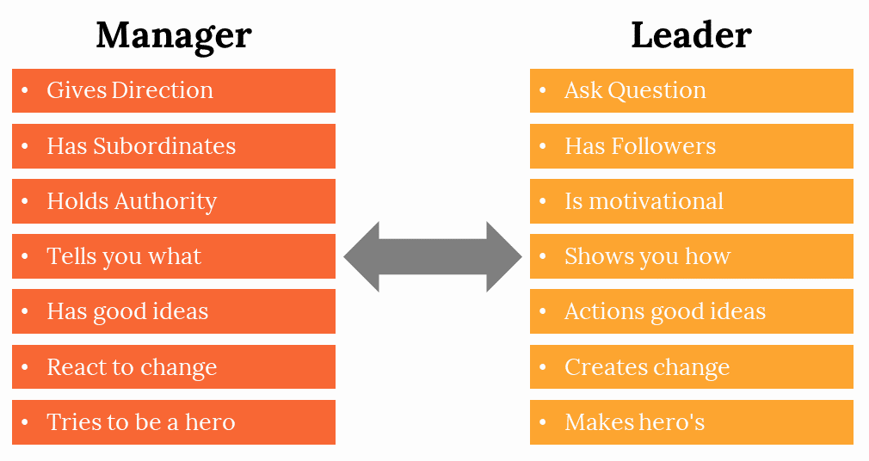

Slide 20
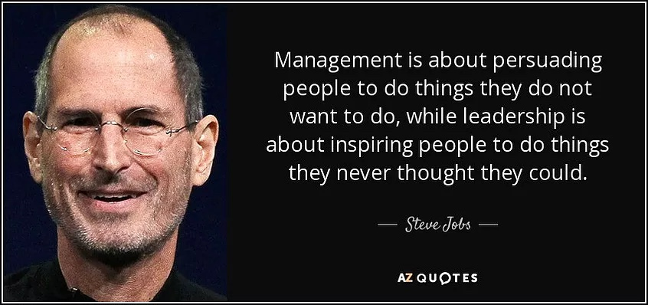

Slide 21

Activity

Slide 22
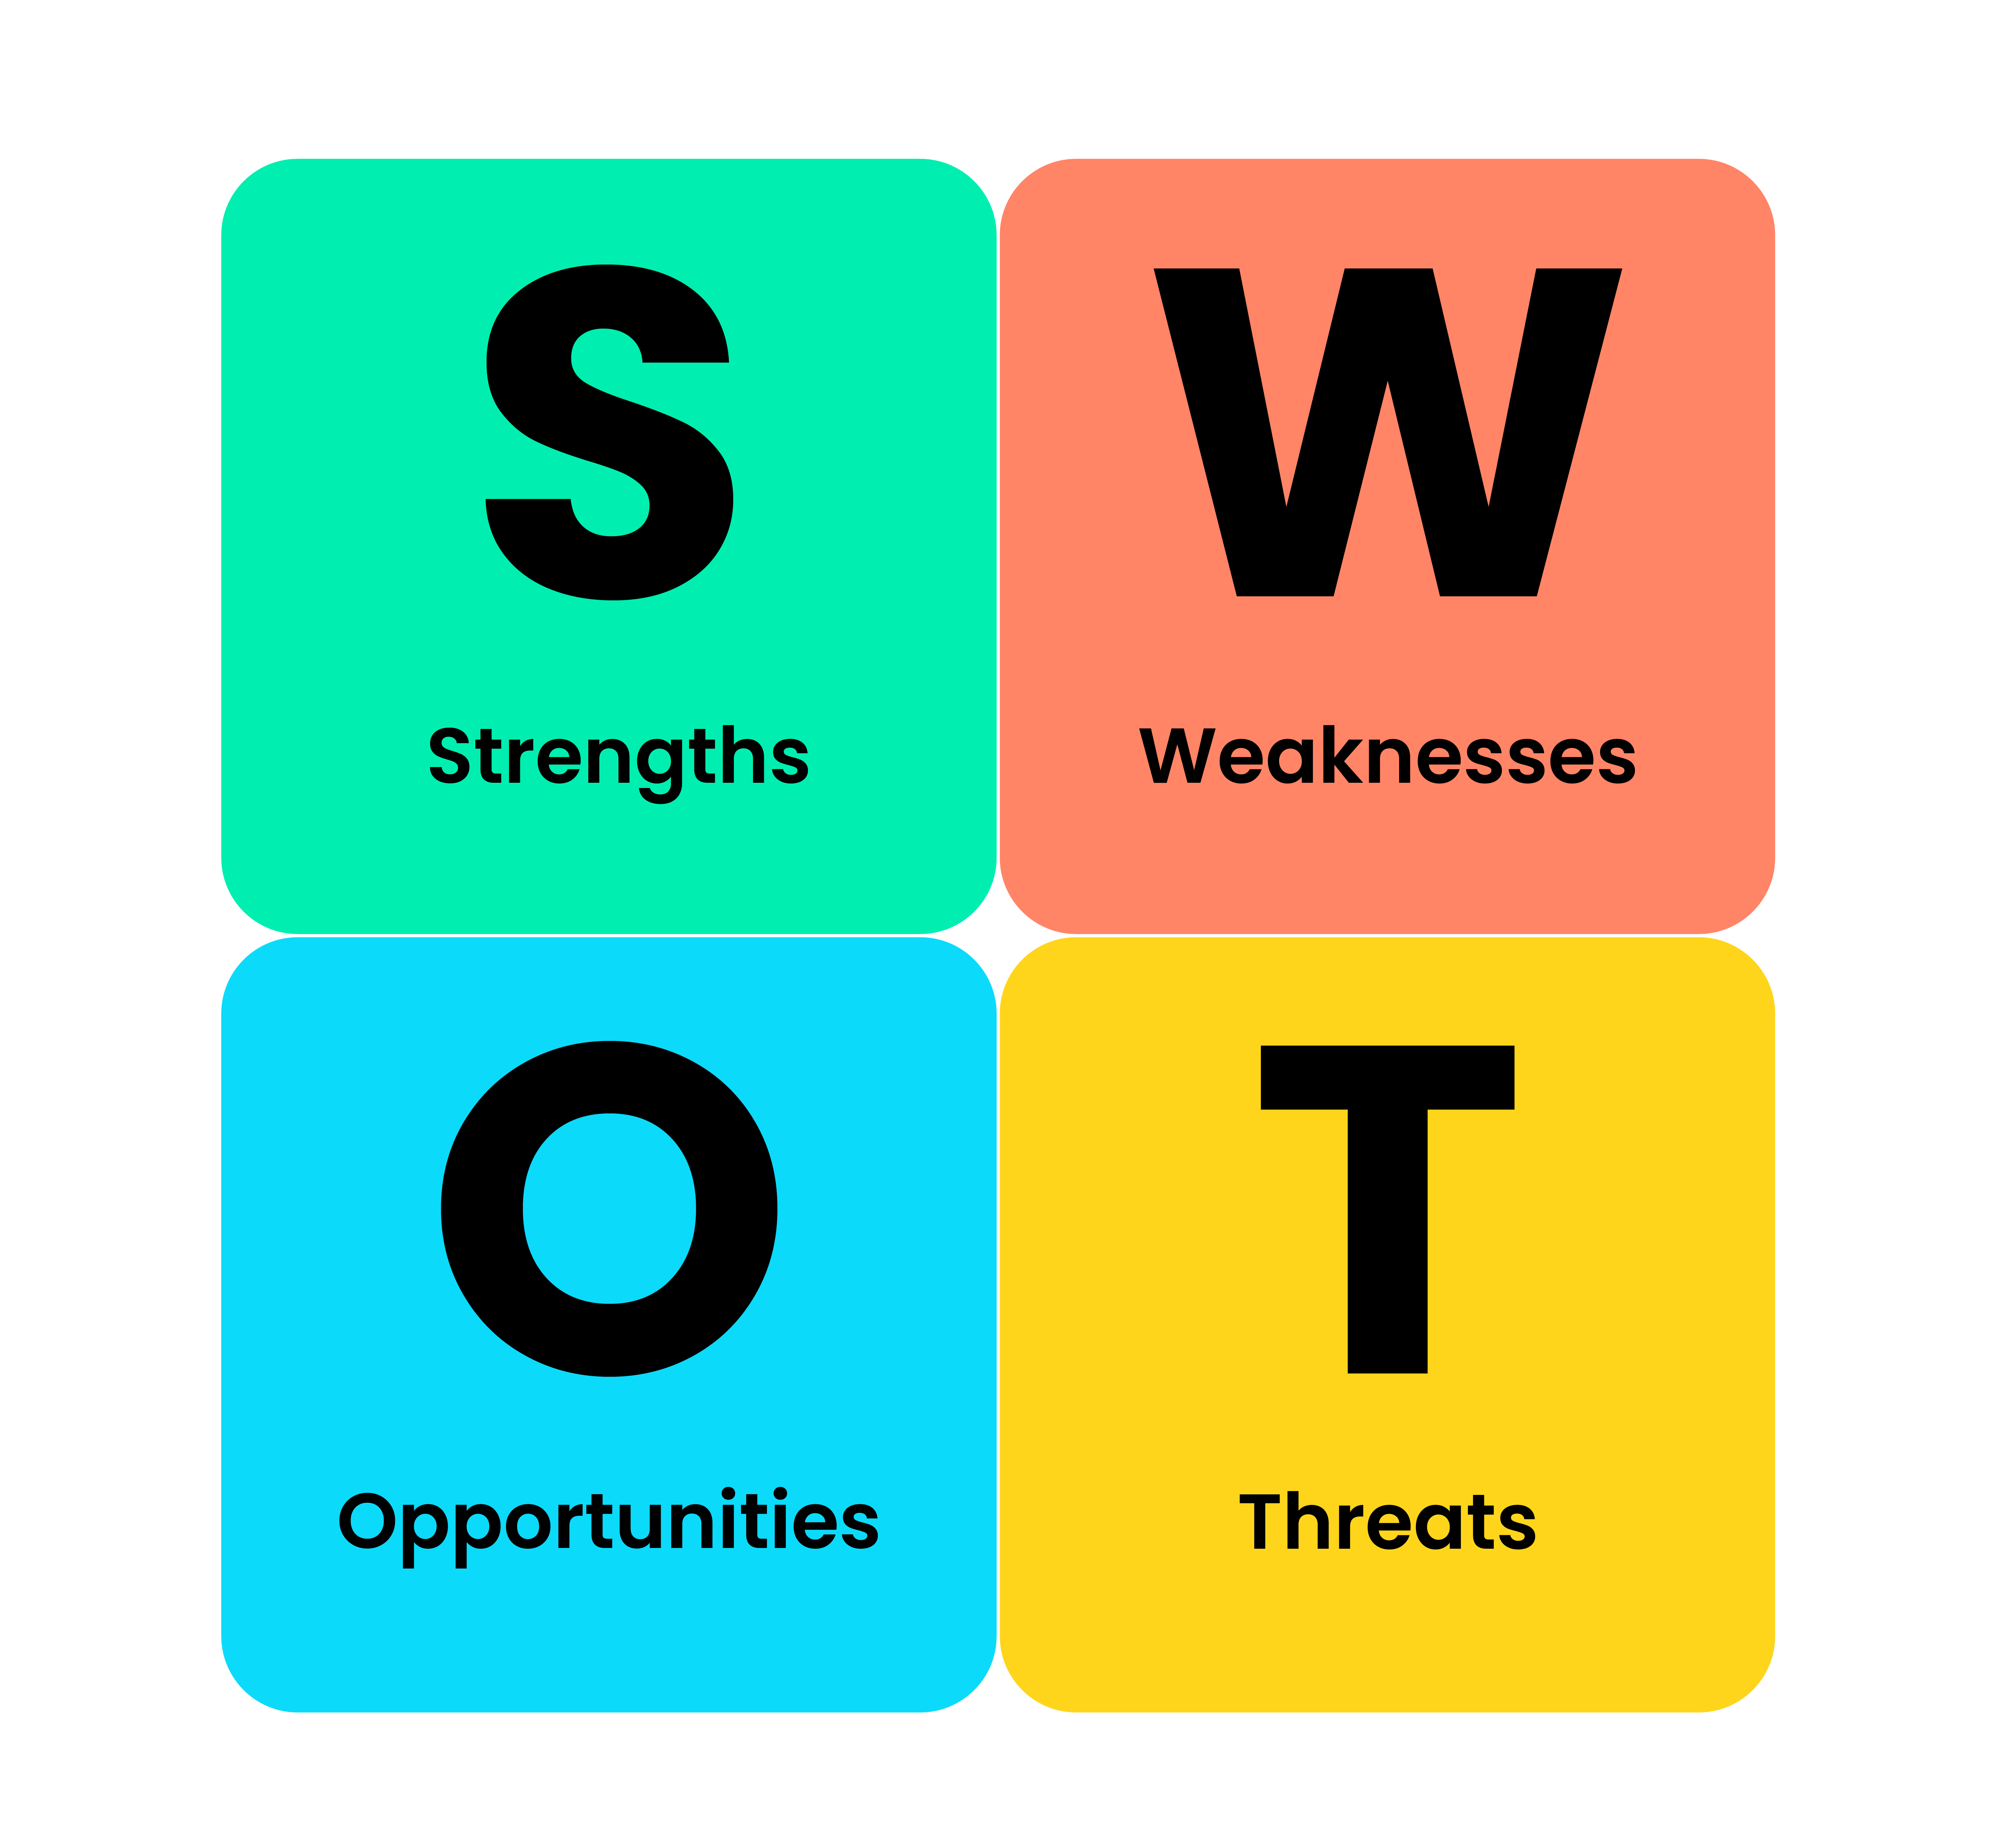
Tutorial Question
Come up with a SWOT analysis in respect of leadership skills

Slide 23


